Slide 1
1873: The Canadian Government Creates the NWMP
To enforced the law and established a Canadian presence in the wild Northwest
paramilitary force
positive relations with Aboriginals
Specifically created to combat:
The American threat
The Whiskey trade

Slide 2
Cypress Hills Massacre 1873
American wolfers attacked a group of Nakoda camping in Cypress Hills
Killed 20 because they thought the Nakoda stole horses
Reaction
People feared the West
prompted the NWMP to step up their efforts to clear the prairies of American traders

Slide 3
The Great March
An effort to establish order in the lawless prairies
- Winnipeg to Fort Whoop-Up
275 NWMP
Their job was to suppress the whisky trade and bring law and order to the west
to protect the First Nations

Slide 4
Arrived at Fort Whoop-Up
First Nations groups were starving
American traders had fled
The First Nations, for a time, welcomed the protective presence of the NWMP
Continued to patrol the North-West Territories for the next 30 years

Slide 5
The Numbered Treaties
Canadian treaties with prairies first nations

Slide 6
What do Treaties Represent?
Negotiated rights between then Crown (Federal Government) and First Nations peoples.
It is a “trust relationship” that exists between the Crown and First Nation peoples.
- Each group trusting the other will fulfill their obligations as stated in the Treaty.

Slide 7
The Numbered Treaties
Also called the Land Cession or Post-Confederation Treaties
Seven signed between 1871 and 1877 with aboriginal groups on the Canadian prairies
granted the federal government large tracts of land throughout the Prairies, Canadian North and Northwestern Ontario for white settlement and industrial use.

Slide 10
Why did the Government Want to Sign Treaties?
Government determined to open the Prairies to European and Canadian settlers
Government determined to gain control of land as quickly and as cheaply as possible

Slide 11
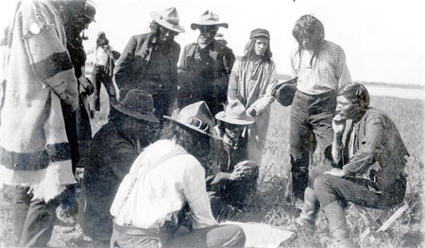
Why the First Nations Signed Treaties
not enthusiastic about making these deals
facing hunger issues due to the disappearing bison.
recognized that they would have to share land and wanted to make the best possible deal to secure the future of their people
Cree examining document showing treaty boundaries

Slide 12
Painting of Treaty Line being Drawn
Thought they were making an exchange- sharing the land for protection and support of their people
Did not recognize that treaties would be permanent – bargained on good faith of someone’s word
No concept of Private property
Land was sacred

Slide 13
What did First Nations Receive from Treaties?
Agreed to share land in exchange for specific rights
In general:
Access to resources, health care (6), education
Right to hunt, to fish, to self government
Reservation land for each family to farm
Farm tools and assistance
Land amounts dependent upon treaty

Slide 14
The Role of the NWMP
Government exploited that trusting relationship
in charge of escorting First Nations from traditional territories to reservations
Influenced FN to sign treaties

Slide 15
The Main Problem with FN Reservation Farms
First Nations excepted to farm like Europeans
One of the key conditions in the Prairie treaties was that the federal government would provide farming tools, seeds, animals, and instruction.
However, in most cases, this farming assistance was never given.

Slide 16
Problems with Fn Reservation Farms
Most had no experience
Prairie soil hard and dry
Seed was sent too late in the year to plant
had to sow seed by hand and harvest their pitiful crops with hand tools.

Slide 17
Problems with Reservation Farms
Oxen provided could not pull plows
Forbidden to use steam-powered threshing machines after a harvest
Plows poorly made

Slide 18
Did the government want farms to fail?
Indian Commissioner Hayter Reed’s attitude illustrated the government’s view:
He believed it was “unnatural” for First Nations to use machinery-
although it is impossible to grow and harvest sustainable amounts of wheat without it
If they grew more than they needed, they were planting too much and wasting crops

Slide 19
Government got the upper hand
By 1900, most FN abandoned farming
The aboriginal people had to rely on food handouts in order to survive.
The government used food to control the Native people and would not give it to people who they saw as troublemakers.

