Slide 1
The Elements of STORY
English 10

Slide 2
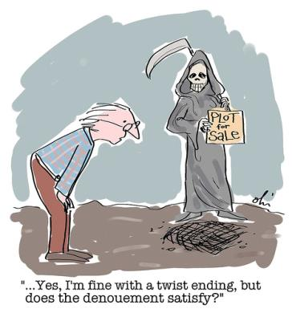
Plot
In short, plot refers to the events that happen during a story. The Plot can be broken down into four sections:
Introduction
Rising action
Climax
Dénouement

Slide 3
Introduction
The section of the plot where the setting and characters are established.
What is the setting of “The True Story…”
Who are the characters?
The elements of the conflict are generally established in the introduction as well
What introduction to conflict do we get in the intro?
Exposition occurs here

Slide 4
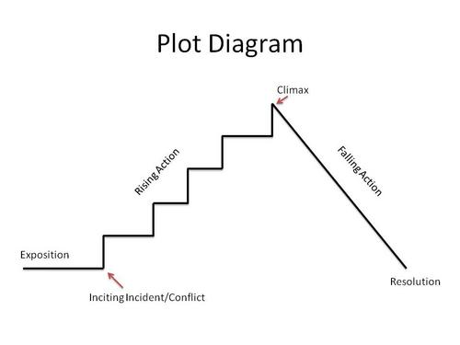
Rising Action
The development of the plot.
conflict is explored in more depth
characters are developed more fully.

Slide 5
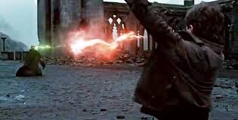
Climax
The most INTENSE part of the narrative.
All action in the story usually leads up to this point.

Slide 6
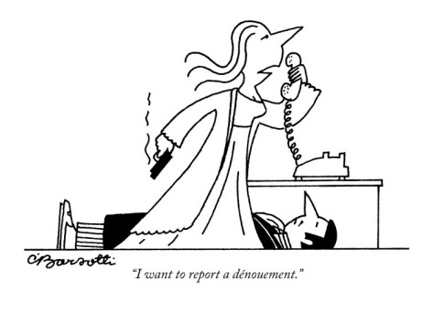
DÉNouement
French for “unknotting”
The resolution of the story.
All (or most) of the loose ends are wrapped up.
Also known as: falling action or resolution.
*complexity of plot*

Slide 7
Additional Plot Devices
Foreshadowing: when the author hints of actions that will occur later in the story.
Flashback: when the author presents scenes that have occurred chronologically before the beginning of the story.
Exposition: writing or speech that informs or explains. Usually, the first part of the story where characters, setting, and the basic situation are established.
*may be used synonymously with introduction in plot

Slide 8
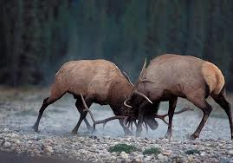
Conflict
The obstacles in the story to be overcome.
There are several different types of conflict:
Internal: when a character struggles with his/her own emotions or sense of right or wrong.
man vs. himself
External: when a character is threatened by some character or force outside of themselves.
man vs. man (woman vs. man, woman vs. woman etc.)
man vs. nature/environment
man vs. the unknown
man vs. the supernatural

Slide 9
Additional Conflict Terms:
Protagonist: the hero of the story.
Usually the main character, usually sympathetic.
Must overcome the conflict in the story.
Antagonist: responsible for creating the conflict.
Acts in opposition to the protagonist.
Usually unsympathetic.
May be human or a non-human creature.
May even be a non-human force, such as the weather.

Slide 10
Characterization
Refers to the author’s presentation and development of a character.
One must ask two questions of characters in literature.
Is the character flat or round?
Flat character: the character has only one or two identifiable personality traits and is easily recognizable as a stereotype. Also known as a stock character.
Round character: the character has many personality traits and seems more like a real person.

Slide 11
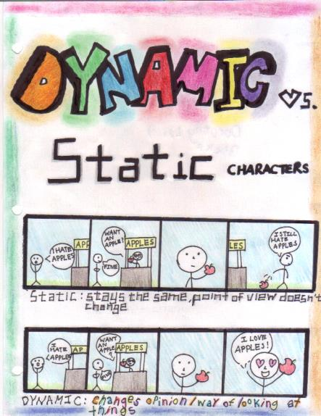
Character. Cont.
2. Is the character static or dynamic ?
Static Character: a character that remains the same throughout the story.
Dynamic Character: a character that changes during the course of the story.

Slide 12
Additional Character Terms
Stereotype/Stock character: a character that possesses expected traits of a group rather than being an individual.
An example is the stereotype of the rugged cowboy or the crazy cat lady.
Direct Presentation: the character is described by the author, the narrator or the other characters.
We are told directly what the character looks and acts like.
Indirect Presentation: a character’s traits are revealed through actions and speech.
We are shown indirectly what a character is like by the way he/she acts.

Slide 13
More terms…
Motivation: the forces that compel the characters to act as they do.
Foil: This is when a character is portrayed as opposite of another character in a particular way. By putting the two characters next to each other, the different characteristic is exaggerated
Eg. Harry Potter and Draco Malfoy
Brennan/Dale and Derek

Slide 14
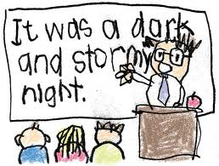
Setting
Establishes the following:
the physical world depicted in the story (time and place)
the social environment of the characters (customs, moral values, etc.)

Slide 15
Point Of View
The perspective from which the story is told. There are several different types:
First Person: The story is told in the voice of one of the characters in the story using “I”. This character is directly involved in the action of the story.
Second Person: The storyteller is speaking directly to the reader using the pronoun “you.”

Slide 16
P.O.V Cont.
Third Person: The storyteller is not directly involved in the action of the story. Divided into three different types:
Omniscient: The author tells the story. The reader can enter the thoughts of all the characters and see all the action in the story. (like God)
Limited Omniscient: The author tells the story. The reader can enter the thoughts and follow the actions of only one character.
Objective: The author tells the story. The reader can enter no one’s thoughts. Much like a straight news report.

Slide 17
Theme:
the central idea or purpose in a literary work; the insight that the author wants to pass along to the reader.
makes some comment on the human condition
common themes are: the nature of humanity, the nature of society, man’s relationship with the world around him
a theme must apply to the reader as much as the characters in the story
the reader may disagree with the author’s viewpoint expressed in the theme

Slide 18
Moral
the “lesson” of the story.
The author implies a judgment on the actions of the characters in the story.
Differs from theme in that the moral implies that the actions of the characters are either good or bad; a theme makes no judgment but simply shows us how we are as human beings

Slide 19
Tone
The writer’s attitude toward the reader and toward the subject.
May be formal or informal, friendly or distant, personal or impersonal.
Humour: The quality that makes something laughable or amusing.
Sarcasm: witty language used to convey insults or scorn.
Irony: literary technique that that involves surprising, interesting, or amusing contradictions (opposites).

Slide 20
Mood/Atmosphere
The feeling created in the reader by the literary work.
This is usually created by the writer’s choice of words, by the events in the work, and by the physical setting.
The author’s tone also plays a large part in setting the mood.
Suspense: the feeling of growing curiosity and uncertainty about the outcome of events in a narrative.
See also Humour.

Slide 21
Genres
A way of dividing literary works into categories.
Some common genres of fiction are science fiction, historical drama, and romance. Some specific genre terms are:
Satire: a type of comedy that ridicules or criticizes the faults of individuals or groups.
Parody: a type of comedy which is an imitation of another work that exaggerates or distorts features of the work to make fun of it simply to amuse the reader/viewer.
Tragedy: a type of drama that shows the downfall or destruction of a noble or outstanding person
*comedy vs. tragedy*

Slide 22
Misc.
Dialogue: a conversation between characters. Punctuated using quotation marks (usually).
Narrative: another word for a story.
Narrator: An outside voice or character within the work tells the story.
Narration: writing that tells a story.

