Slide 1
English 10
February 5th, 2014

Slide 2
Today:
Written Response
Finish Grace Period Plot Summary/Diagram
Discuss
Inciting Incident/Conflict mini lesson
Application

Slide 3
Respond.

Slide 4
“Grace Period”
Grab a copy of Inside Stories and review “Grace Period”.
Continue your plot summary from yesterday (rising action, climax, denouement).
Be prepared to discuss.

Slide 5
ANOTHER plot Feature—Inciting Incident
Take notes ☺
Inciting comes from the Latin word incitare which means “to put into rapid motion, urge, encourage, and stimulate.”
And that’s exactly what your inciting incident is: it’s an event that catalyzes your hero to “go into motion” and take action.
What it does:
it jolts your hero out of his everyday routine
it is the event which sparks the fuse of your plot

Slide 6
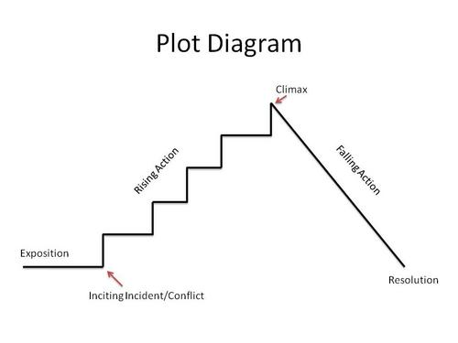
A visual…

Slide 7
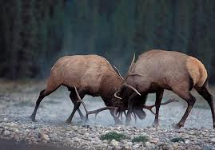
Conflict
The obstacles in the story to be overcome.
There are several different types of conflict:
Internal: when a character struggles with his/her own emotions or sense of right or wrong.
man vs. himself
External: when a character is threatened by some character or force outside of themselves.
man vs. man (woman vs. man, woman vs. woman etc.)
man vs. nature/environment
man vs. the unknown
man vs. the supernatural

Slide 8
Additional Conflict Terms:
Protagonist: the hero of the story.
Usually the main character, usually sympathetic.
Must overcome the conflict in the story.
Antagonist: responsible for creating the conflict.
Acts in opposition to the protagonist.
Usually unsympathetic.
May be human or a non-human creature.
May even be a non-human force, such as the weather.

Slide 9
Application:
Detail the conflict in “The True Story…” and “Grace Period”
Questions to answer:
Who is the protagonist?
Who is the antagonist (or perhaps, what)?
What kind(s) of conflict occur(s)? (be specific—no internal)
Try and locate the “inciting incident” for each story

Slide 10
Making it Personal
Write a well-developed paragraph detailing a personal experience with conflict in your own life.
Title it accordingly (the kind of conflict) e.g. “Mrs. Grey versus the Bear” (or something like that)
“In a classic case of man, or rather, woman versus nature, I found myself in a battle of wills against a feisty mama bear one October evening…”

