Slide 1
Credit Cards and Other Debt
Tuesday, Jan 21st

Slide 2
Class Overview
Intro to Credit
Story
Credit Card Debt
Consumer Credit
Dangerous Debt Practices

Slide 3
Credit Card Debt
Credit has become an essential financial tool and a convenience
Most students will take on significant amounts of debt in establishing their education and career
However, using credit also has significant costs and many young people do not know how to plan for or manage the costs of debt

Slide 4
Are Canadians Being Crushed By Debt?
Six in ten Canadians aged 18 to 29 say they currently have some debt, with credit card debt being by far the most common, followed by student loans
Students owe an average of $28,000 in student loans when they graduate from post-secondary education

Slide 5
Are Canadians Being Crushed By Debt?
Half of credit card users don’t pay their balance each month, and pay interest at rates ranging up to almost 30% per year
For every $100 in assets, the typical Canadian family unit has $13.52 in debts
In 2000, both Visa and American Express launched credit cards for youth aged 12 to 18

Slide 6
Story Time
Why was Quinn concerned after he maxed out his credit cards?
Because he had to pay back the money he had charged, as well as interest at a very high interest rate.
How did Gaia’s offer help Quinn?
Gaia offered to help him get a loan at a lower interest rate to pay off the high-interest credit cards

Slide 7
Story Time
What’s something you might need to borrow money for after you graduate from high school?
Young people often need loans for:
Their education
To get supplies and equipment to start a career
To move to a new location
To buy a car
Etc.

Slide 8
Group Work
Find the credit card statements for your character (Module 10)
Record the balance of the credit card and the interest charges

Slide 9
Discussion
Why did your characters use credit cards?

Slide 10
Discussion
How is a credit card different from a debit card?
Debit card = money transferred directly from your account to the seller’s account (you cannot spend more than you have in your account)
Credit card = a type of short-term loan to pay for purchases, but you have to pay the loan back by the due date to avoid and minimize interest charges

Slide 11
Credit Cards
You have to apply for a credit card
Credit card companies charge interest and fees
Cards only approved after a credit check
Based on reasonable income and a good credit history
Usually excludes high school students (unless guaranteed by an adult)
Spending limits vary with the cardholder’s income and credit rating

Slide 12
Credit Cards
There are many different types of credit cards:
Bank cards (Visa, MasterCard, etc.)
Store cards (The Bay, Canadian Tire, etc.)
Travel or entertainment cards (American Express, Diner’s Club, etc.)
→ They all have different features, repayment rules and interest rates (store cards often have much higher interest rates)

Slide 13
Credit Cards
Financial institutions issue credit cards in order to make money.
They charge interest and sometimes other fees to cover their costs and profits
They also charge merchants for using credit card systems

Slide 14
Discussion
Why are credit cards widely used?
Convenience
Safer than carrying cash (especially in large amounts)
Some retailers require credit cards (hotels, airlines, and car rentals)
Online purchases
Cash advance for emergencies
Statement can be useful for recordkeeping

Slide 15
Costs of Credit
If you pay your credit card bill in full by the due date, you’re not usually charged interest on purchases
However, on cash advances, interest is charged from the day you take out the money
Interest charges add to the cost of a purchase
Interest varies from 10 to 30% (much higher than any interest you’ll make off any savings)

Slide 16
Costs of Credit
Imagine you just bought a $450 touch-screen music player using a credit card with an 18% annual interest rate.
Guess the total cost to buy the music player if you paid only the minimum amount required

Slide 17
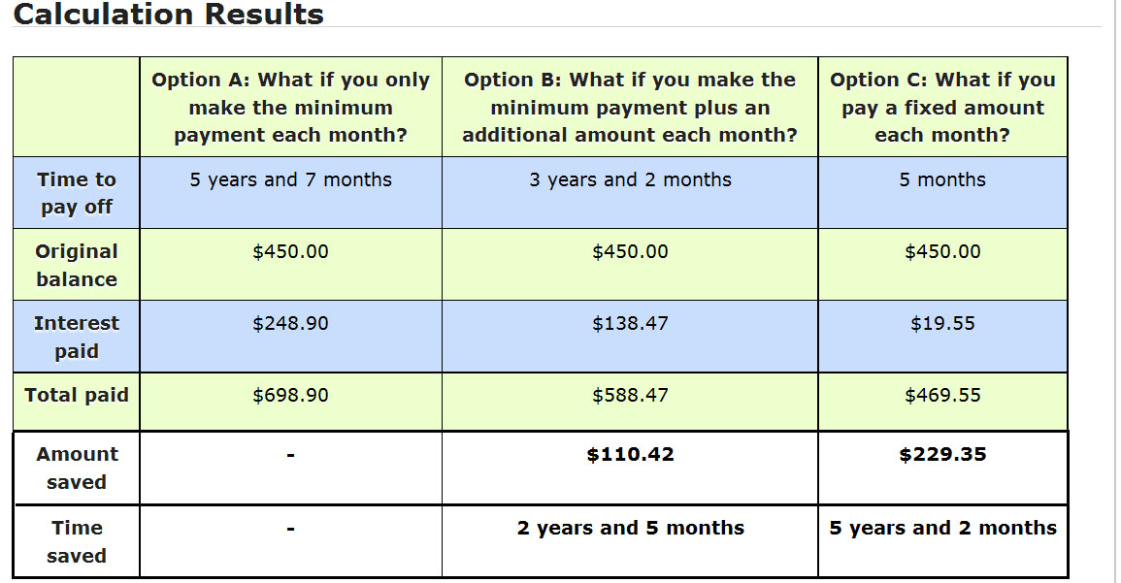
Cost of Credit
$450 credit card loan at 18% interest
Option B: If you pay $5.00 more than your minimum payment each month, you will pay off your credit card balance 2 years and 5 months sooner and you will save $110.42 in interest.
Option C: If you pay $100.00 each month instead of the minimum payment, you will pay off your credit card balance 5 years and 2 months sooner and you will save $229.35 in interest.

Slide 18
Other Forms of Credit
What other forms of credit are commonly used in Canada?
Loan from a bank or other financial institution
Mortgage
Line of Credit
Deferred payment plan
Overdraft protection

Slide 19
Other Forms of Credit
Loan:
From a bank or other financial institution
Must repay on a specified schedule
Interest and other additional fees
Mortgage:
Loan → usually for buying a home
Lender can take possession of property if loan is not paid on time

Slide 20
Other Forms of Credit
Line of Credit (LOC)
A type of pre-approved loan
Allows you to borrow money when you need it up to a maximum amount
Deferred Payment Plan
A purchase plan in which you delay paying for a purchase for a specified time
Usually pay the amount in installments with interest

Slide 21
Other Forms of Credit
Overdraft protection
An arrangement with a financial institution that lets you take out more money than you have
You must pay monthly fees and interest

Slide 22
Responsible Use of Credit
Borrow only what you can repay
Getting too deeply in debt can keep you from reaching your goals
Trying to keep up the payments can mean taking money away from other wants and needs (including your school and career budget)
The consequences of not paying (collection agency, lawsuits or even bankruptcy) could follow you for many years → could make it impossible to finance your education or purchase a home

Slide 23
Responsible Use of Credit
Understand your contract before signing
A credit contract is a legal contract
If you aren’t sure what it means, don’t sign until you do understand and accept the terms (this is not like updating itunes!)
Pay amounts as agreed
You agree to terms like minimum payments, dates of payment, interest rates, etc.
You’re required live up to the terms

Slide 24
Responsible Use of Credit
Keep cards, PINs and passwords secure
It’s your responsibility to keep them secure so that no one can use them
You could be responsible for charges someone else makes using your PIN
Losing your card or giving someone else access to it could result in identity theft or damage to your credit rating

Slide 25
Responsible Use of Credit
Check your credit card slips and statements
Checking your statement is the best way to avoid mistakes and detect fraud
Check the credit card slip for each purchase against your monthly statement
You can often check your transactions online before your statement arrives
If you find an error or a transaction that’s not yours, immediately contact the credit card company, and ask for details or dispute the charge

Slide 26
Misuse of Credit
“Have what you want!”
“Buy now, pay later!”
These ideas sound appealing, but sooner or later you have to pay
Around 100,000 Canadian consumers declare bankruptcy each year, often due to misuse of credit
Remember, focus on real needs, both now and in the future.

Slide 27
Misuse of Credit
For many people, credit makes it easy to but things they can’t afford
They give in to the desire to have things immediately, even if they don’t have the money for them
Think about having access to $5,000 right now and what you would buy → THEN think about how long it would actually take you to earn $5,000...

Slide 28
Misuse of Credit
Even though everyone is tempted to give in to these impulses, you can practice focusing on real needs over time
Avoid impulse buying → wait a day or two to see if you still really want the item
If you can resist short-term impulses, you will get closer to what you really want

Slide 29
SUMMARY
Don’t borrow more than you can comfortably repay. Pay all loans in full, on time.
A credit card is a form of loan, which can have a variety of interest rates and repayment terms
Using debt can have advantages, but it has a cost in the form of interest and other charges
Different forms of debt may be used at different stages in your life. Types of debt include credit cards, student loans, lines of credit, deferred payment plans and mortgages.

Slide 30
QUIZ

